Slide 1
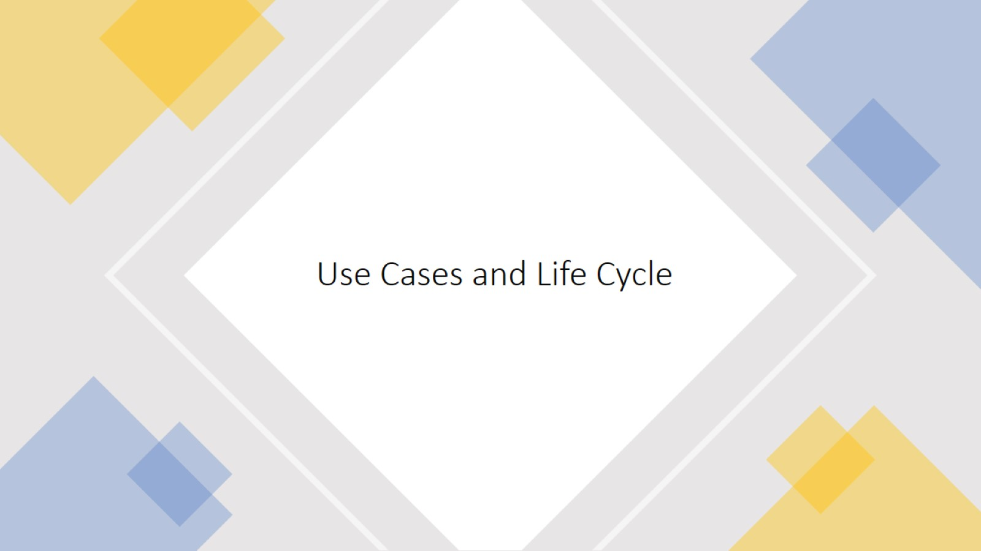
Use Cases and Life Cycle

Slide 2
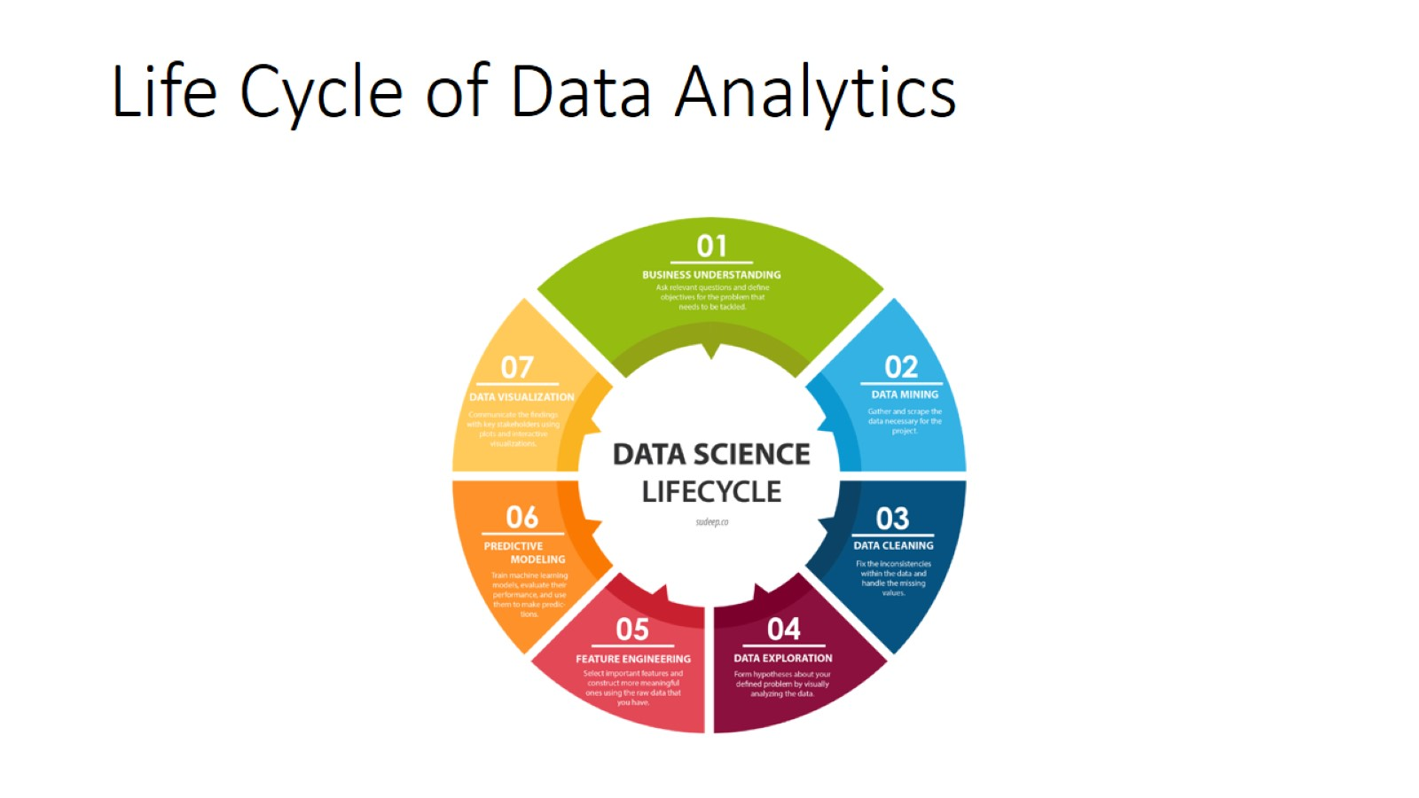
Life Cycle of Data Analytics

Slide 3
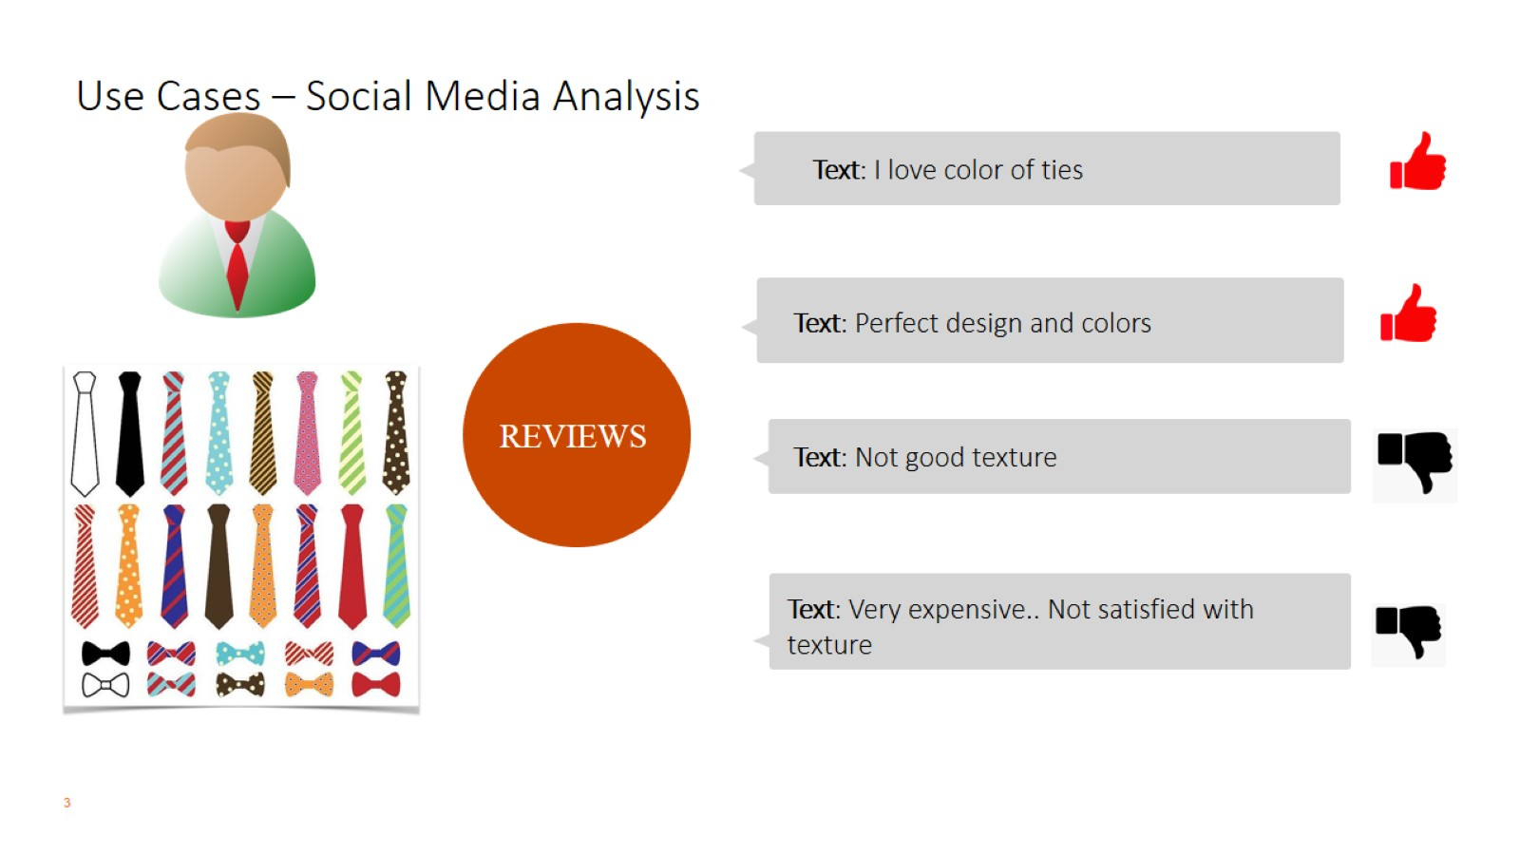
Use Cases – Social Media Analysis

Slide 4
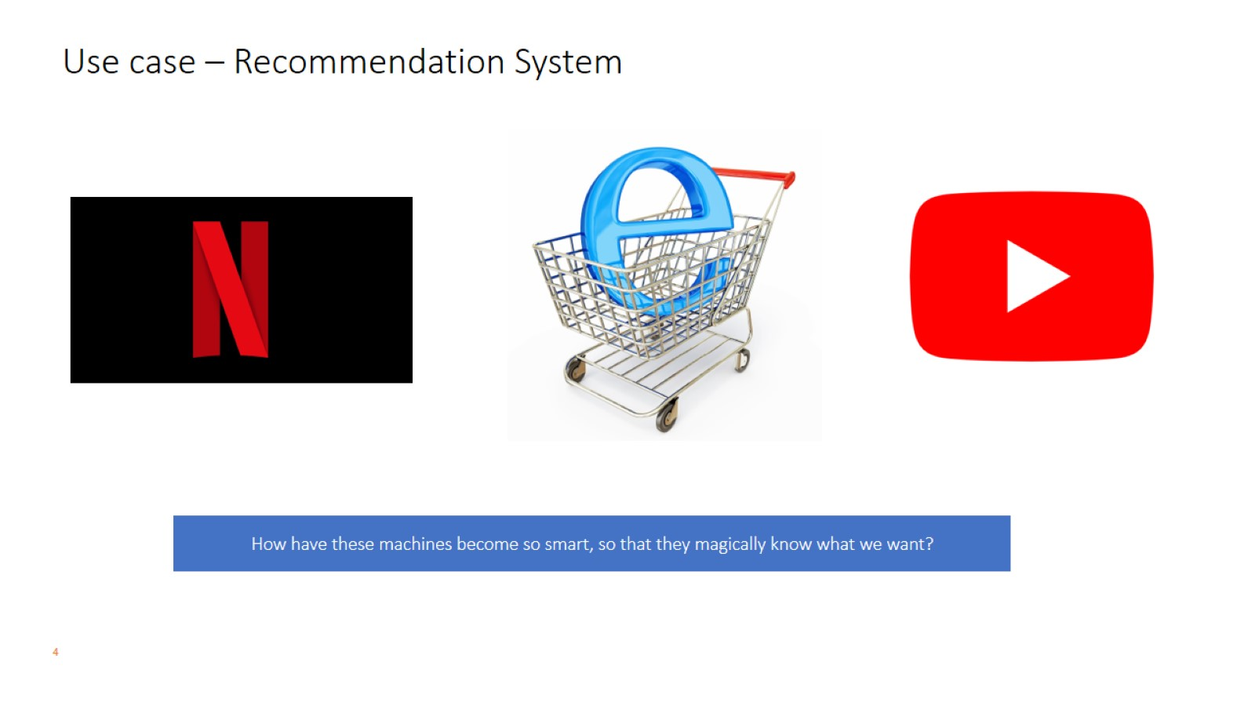
Use case – Recommendation System

